Slide 1

I- spy -oT
Eye

Slide 2
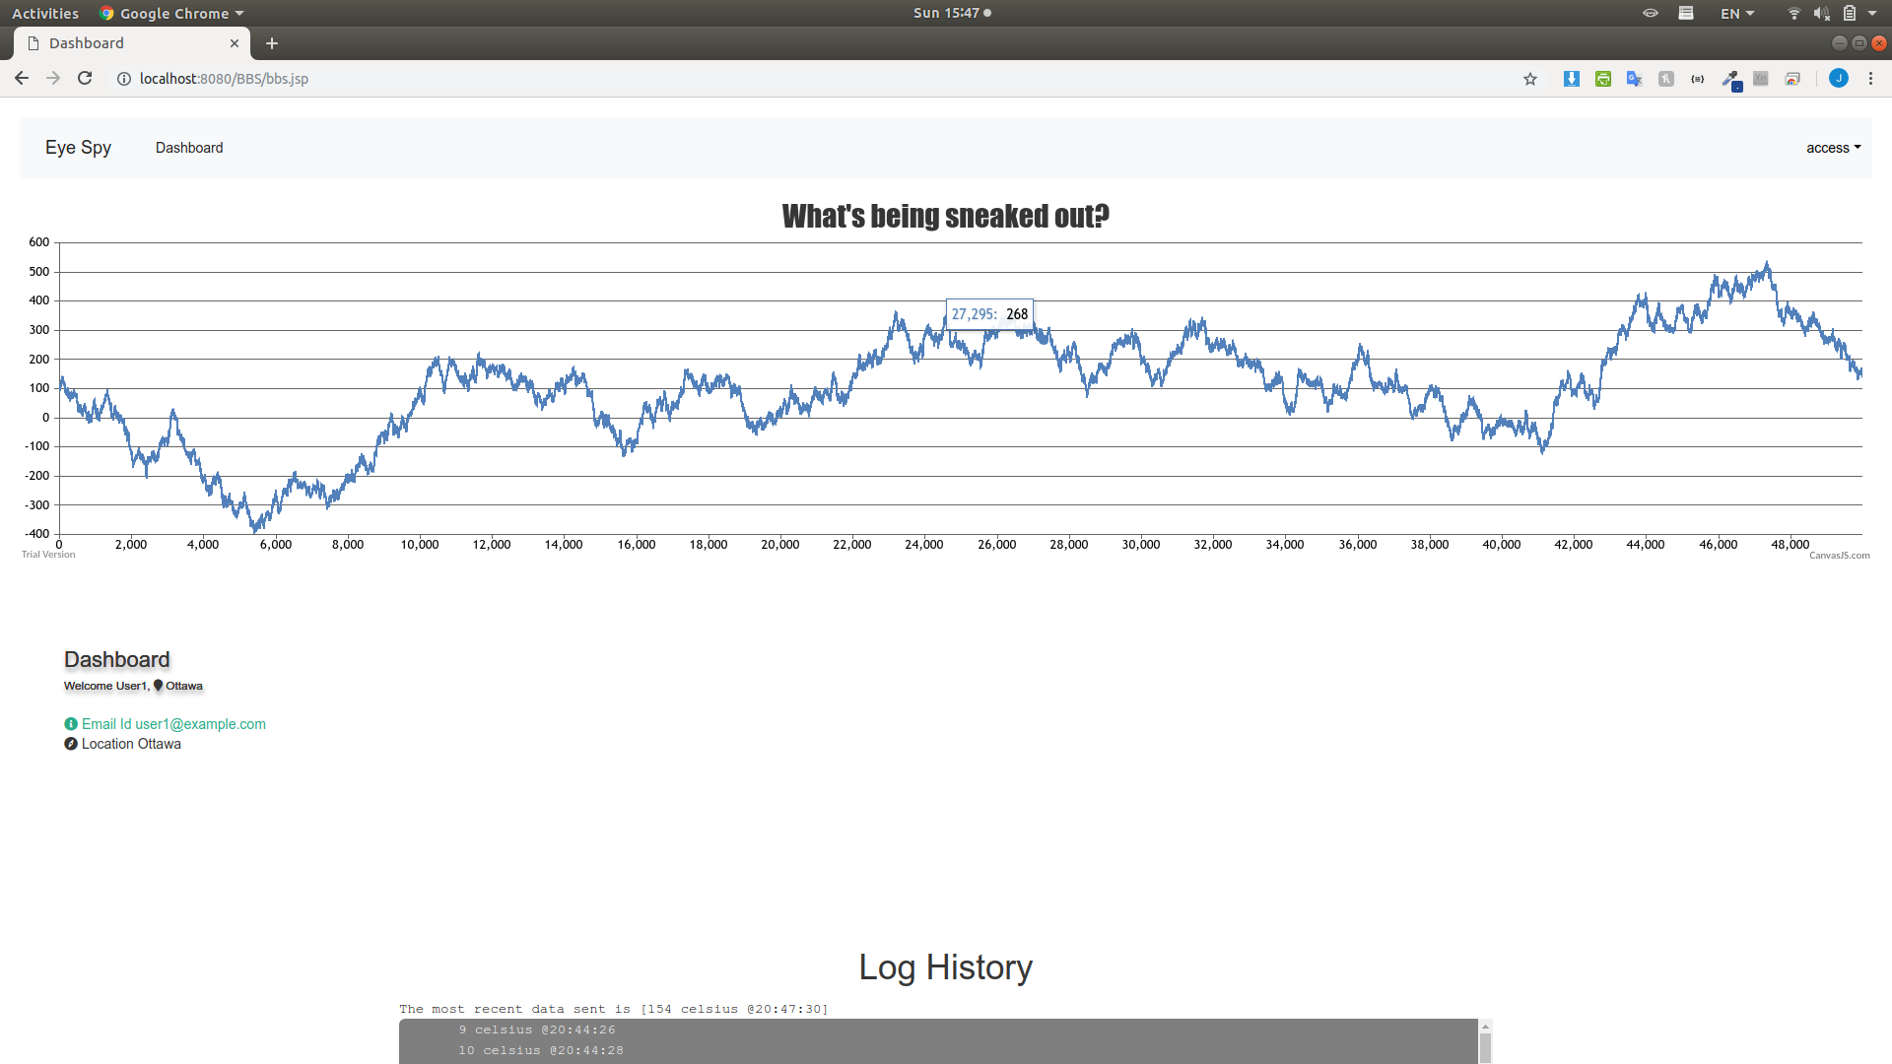
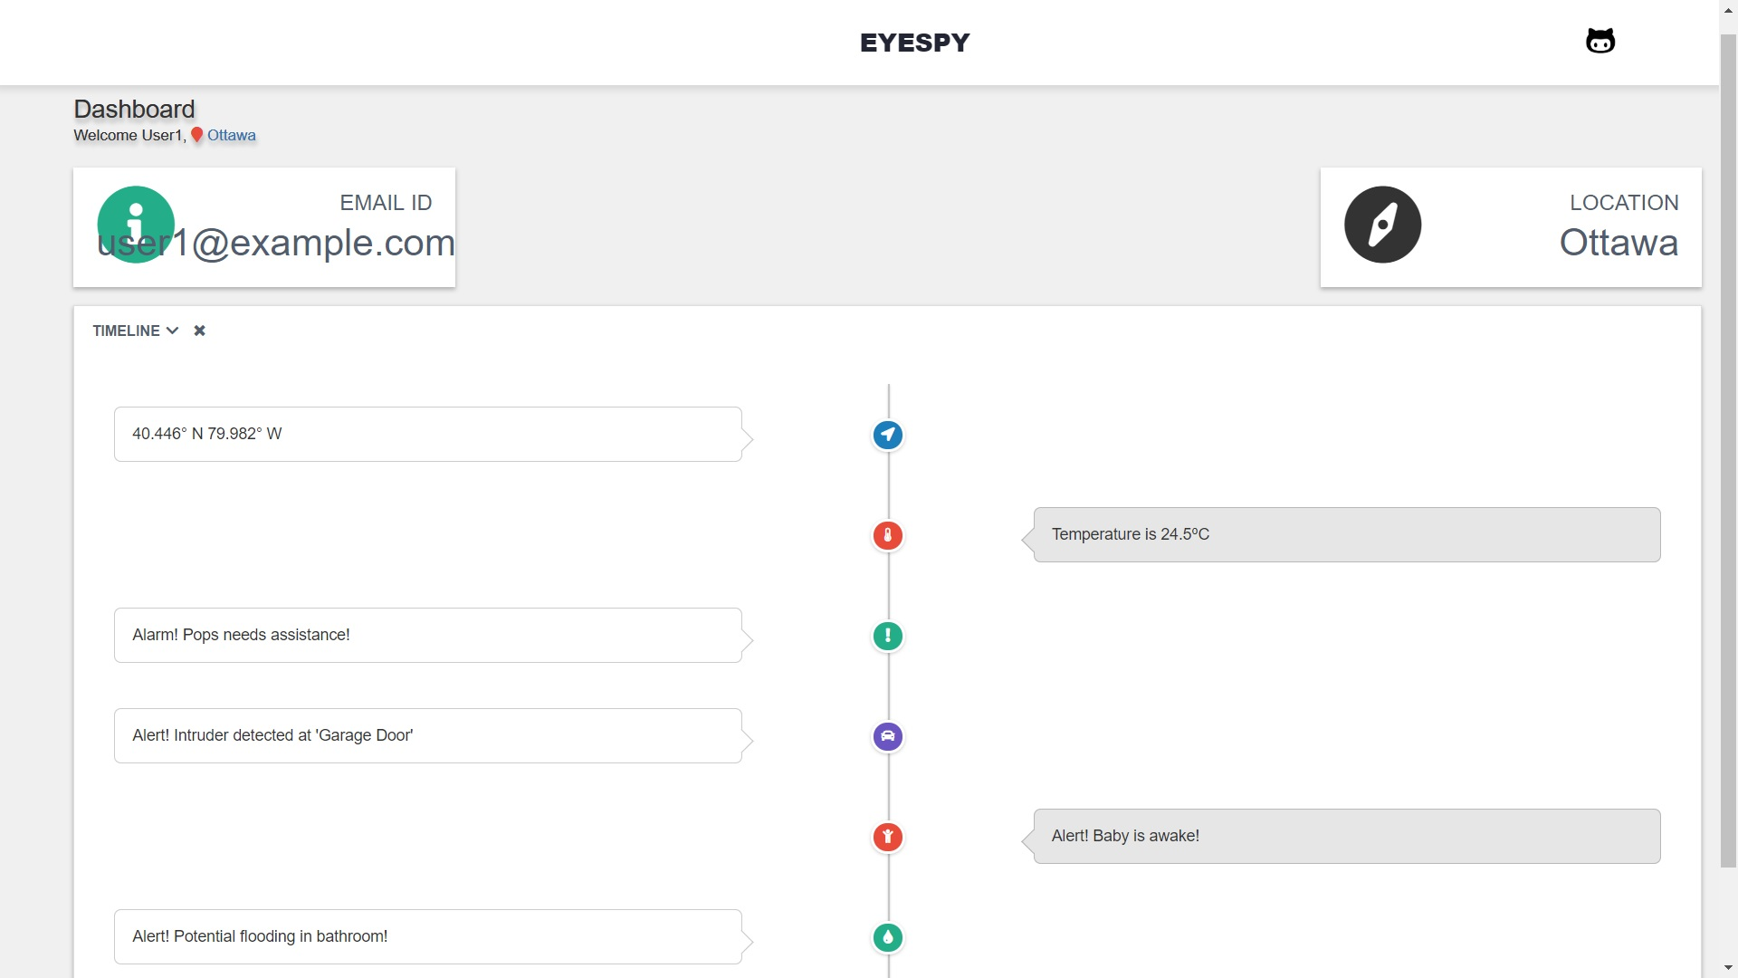

Slide 4
2.5 Quintillion bytes
IOT Data per DAY is generated

Slide 5
20 Billion
IoT Devices are connected

Slide 6
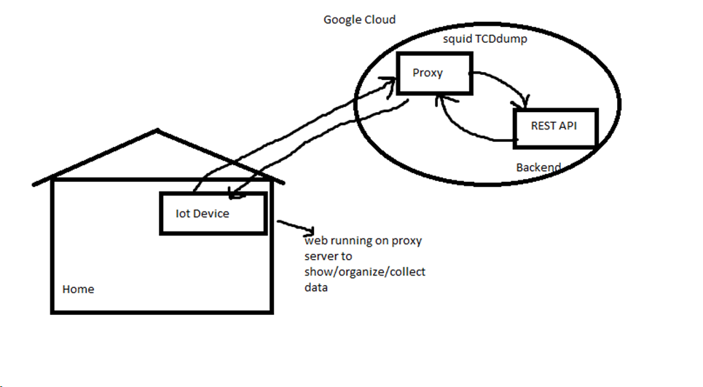
High Level Diagram

Slide 7
Protect your Home
Protect your family

Slide 8
See what data people are stealing
Be in the KNOW!

Slide 9
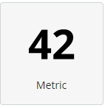
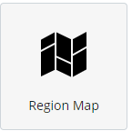
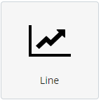
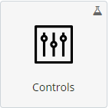
Photo
Info
Biggest Threats
Add devices
Location
Is your Connection Secure ?
Profile
Log Activity
………...
……….
…….
Number of Connected Devices
Eg 6 devices
Geo IP
Charts
Activity Trends over time (line Graph
Alert Center
……
…..
...
Controls

Slide 10
“There are a large number of IoT companies and startups, but many appear not to care about security, and neither, apparently, do the retailers who sell these devices to consumers”

Slide 11
"Several of the devices we tested were painfully insecure”

